Slide 1
Data Analysis Report on Demographic Data in New York City Public Schools 2015-16
Prepared by ,
Lazima Parveen

Slide 2
The analysis of “New York city 2015-2016 Demographic Data - Grades K-8 School”
1. As instructed by the, downloaded the Json data from this link
2. The data consist of 6924 rows and 70 columns.
3. For the data wrangling(cleaning of data), I used Jupyter notebook and Exploratory software
4. The data loaded to exploratory as JSON was analysed and a knowledge about the data was made.
5. The columns with unuseful data was removed using drop method and the remaining columns were named according to the data it contain.
6. The data was then exported as a json file and then imported in to Jupyter notebook.
7. The data in the type of dict was then converted to dataframe using pandas.
Data types of the columns were changed to int and float accordingly using astype() method.

Slide 3
9. The columns containing no information(containing zeros in all rows) has been
removed.
10.The data was grouped using pandas.groupby() by school name based on total enrollment .
11.Most popular schools,Enrollment based on category and schools with high female population were visualised using matplotlib.
12.Other visualisations such as Gender Ratio,Enrollment based on Grades,Test takers was done using Power BI,tableau and excel.
Click here to download the code used for analysis(jupyter notebook file-includes 3 visualisations)

Slide 4
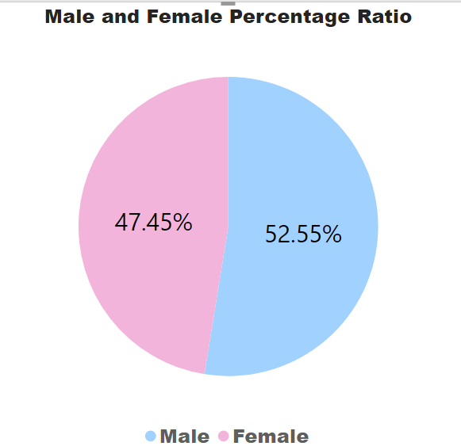
Insights From The Analysis Performed
From the visualization we are able to understand many information,Some are,
The data contains information about 1166 Schools with a total of 639829 number of students .
The male and female ratio out of total enrolled students are 47% and 52%
Female
Female
Male

Slide 5
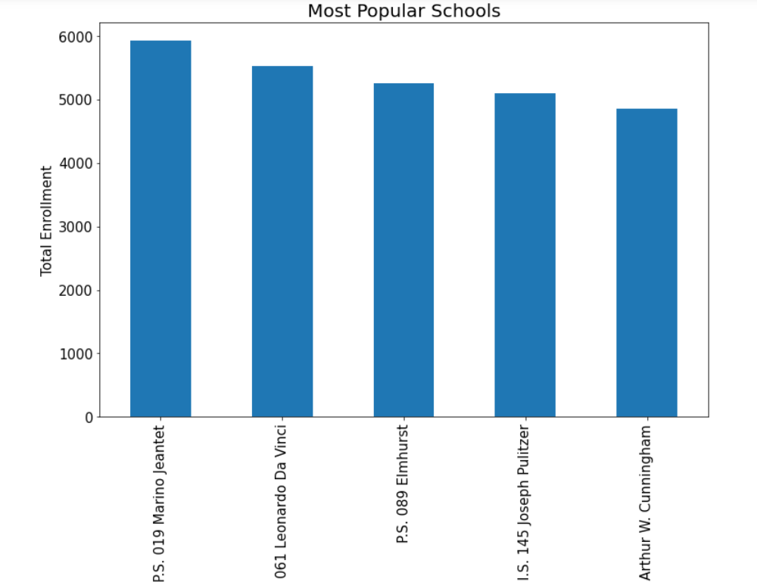
Most popular 5 schools on the basis of Total Enrollment
From this ,P.S.019 Marino Jeatnet is identified as the most popular school

Slide 6
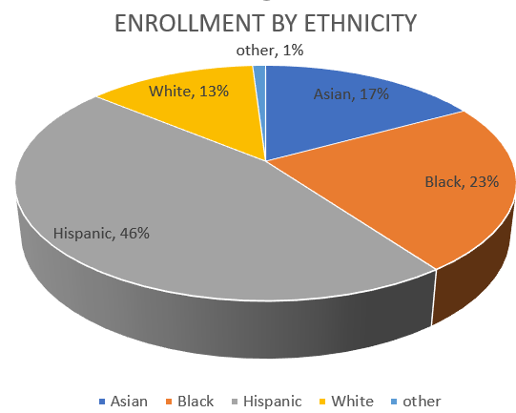
Out of the total enrolled students ,majority of students are Hispanians(46%) followed by Blacks(23%),Asians(17%),Whites(13%) and Others(1%)
Hispanians
White

Slide 7
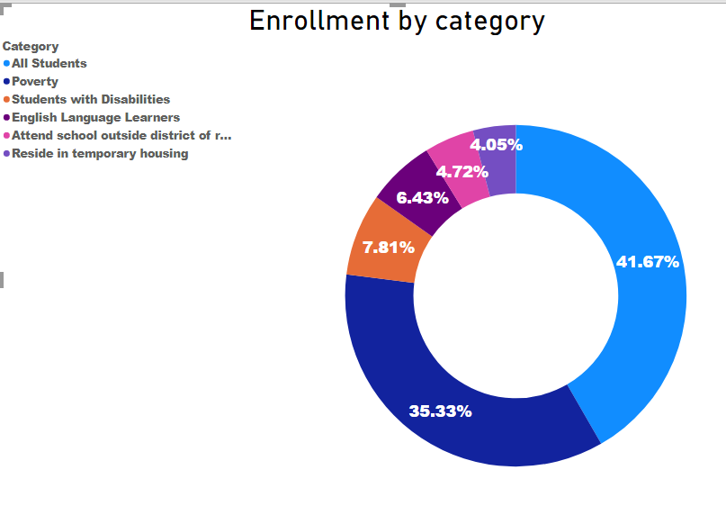
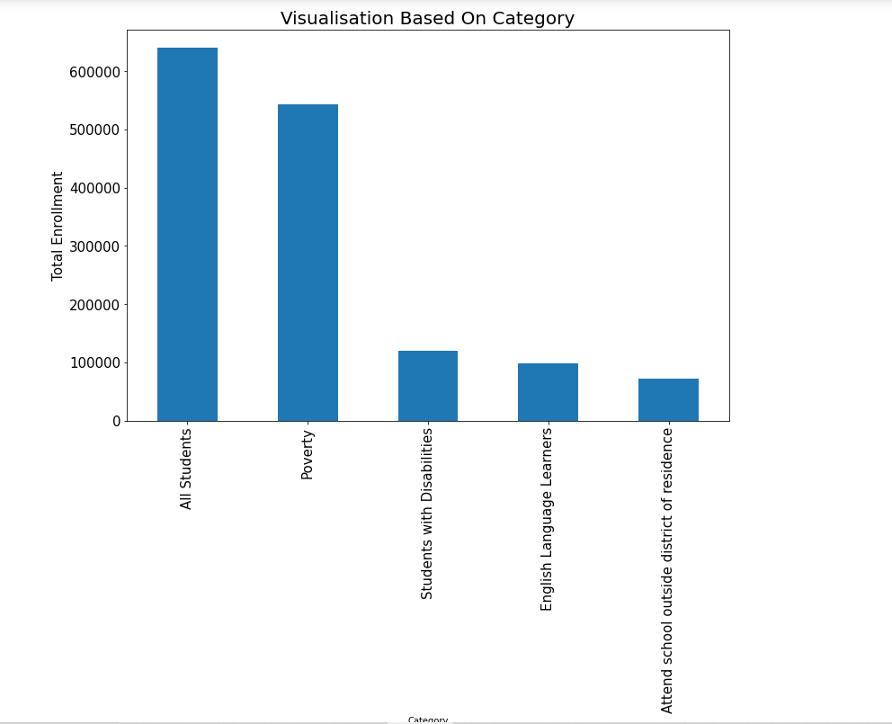
The data has categorised students in to:
English Language Learners
Poverty
Reside in temporary housing
Students with Disabilities
Attend school outside district of residence
Out of 41.67% of total students 35.33% suffers from poverty.
About 7.81% of students are with disabilites.
English language learners are limited to 6.43%
4.05% of students resides in temporary housing
From this ,We can conclude that most of the students admitted NewYork city public schools belongs to the category poverty.

Slide 8
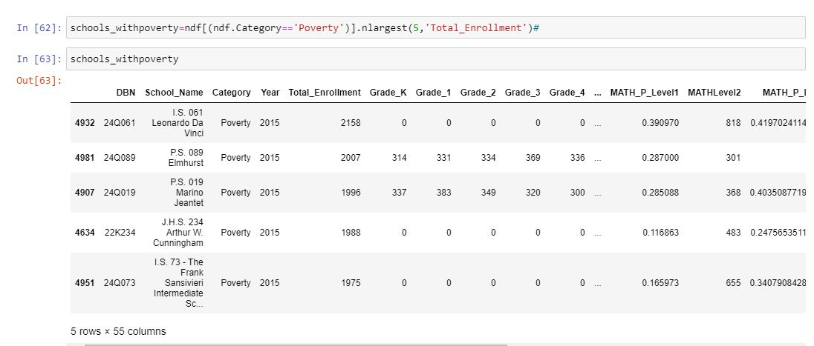
The top 5 schools with highest number of students enrolled under poverty category.
I.S.061 Leonardo Da Vinci School contains highest number(2158) of students under poverty category.

Slide 9
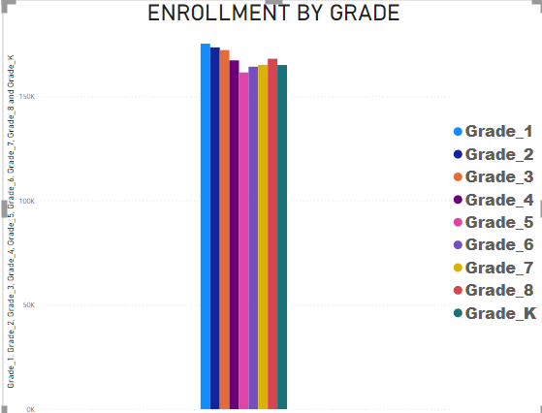
The data contains information about student enrollment up to Grade 8
Out of this the highest number of students are enrolled in Grade 1

Slide 10
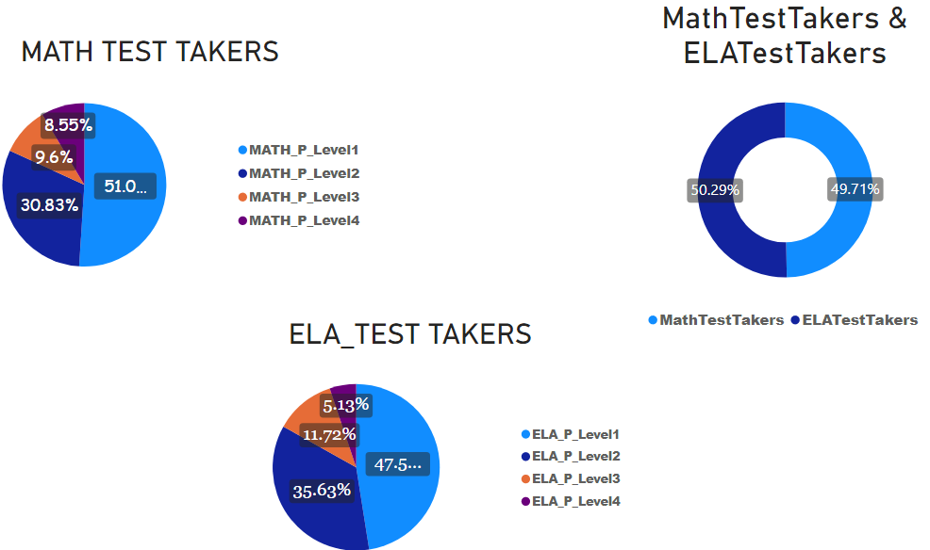
The Math and English test takers ranges between 50.29% and 49.71%
Level 1 has the highest no:of test takers both in Maths and English
Level 4 ELA test takers are low compared to level 4 Math test takers.

Slide 11
THANK YOU

